Slide 1
Properties of Relations
Session 13-14
Course : MATH6182 – Discrete Mathematics
Effective Period : September 2021

Slide 2

These slides have been adapted from :
Susanna S.Epp, “ Discrete Mathematics with Applications”, 5th edition,2020, Cengage, Boston, USA, ISBN 9781337694193
Chapter 8
Acknowledgement

Slide 3


Learning Objectives
On successful completion of this Course, students will be able to:
LO 3
Explain set theory, properties of function, fuzzy set, and relations

Slide 4
Sub Topics
1
Relations on sets
2
Reflexivity, Symmetry, and Transitivity
3
Equivalence Relations
  Partial Order Relations
3

Slide 5
Relations On Sets
Strange As It May Sound, The Power Of Mathematics Rests On Its Evasion Of All Unnecessary Thought And On Its Wonderful Saving Of Mental Operations. —Ernst Mach, 1838–1916

Slide 6
Relations
If we want to describe a relationship between elements of two sets A and B, we can use ordered pairs with their first element taken from A and their second element taken from B. Since this is a relation between two sets, it is called a binary relation.
Definition
Let A and B be sets. A binary relation from A to B is a subset of A×B.

Slide 7
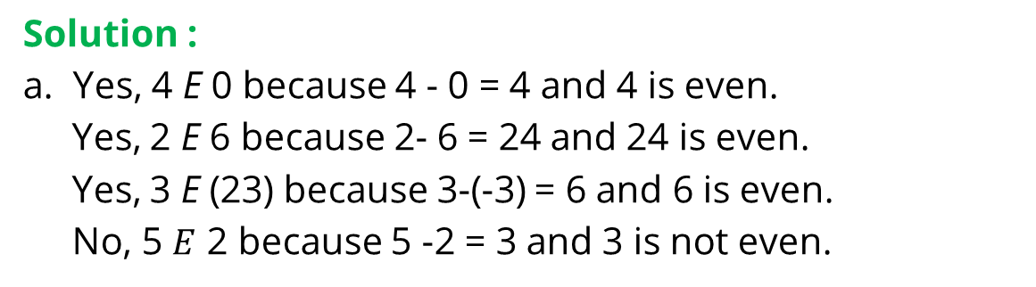
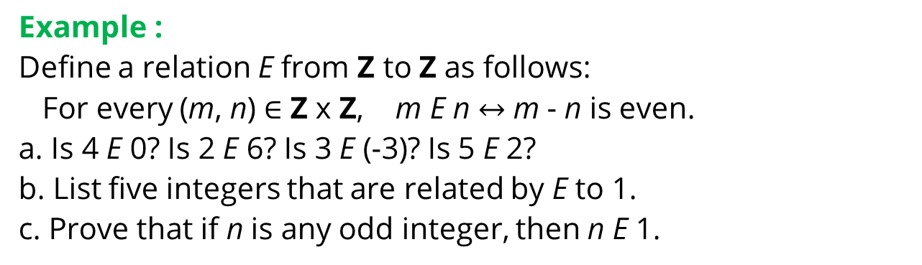
The Congruence
Modulo 2 Relation
Example :
Define a relation E from Z to Z as follows:
For every (m, n) $∈$ Z x Z, m E n $↔$ m - n is even.
a. Is 4 E 0? Is 2 E 6? Is 3 E (-3)? Is 5 E 2?
b. List five integers that are related by E to 1.
c. Prove that if n is any odd integer, then n E 1.
Solution :
a. Yes, 4 E 0 because 4 - 0 = 4 and 4 is even.
Yes, 2 E 6 because 2- 6 = 24 and 24 is even.
Yes, 3 E (23) because 3-(-3) = 6 and 6 is even.
No, 5 $E$ 2 because 5 -2 = 3 and 3 is not even.

Slide 8
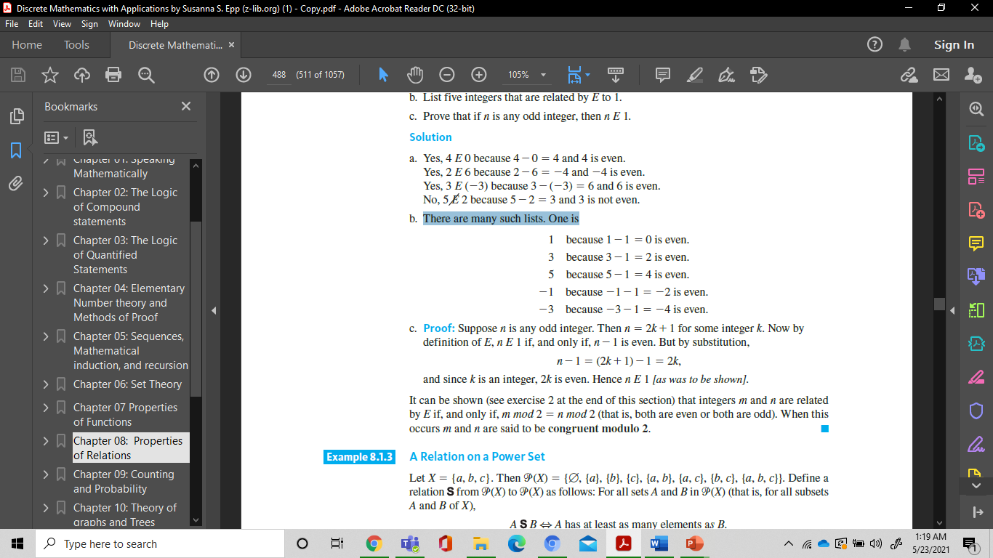
Example : The Congruence
Modulo 2 Relation
b. There are many such lists. One is
c. Suppose n is any odd integer. Then n = 2k+1 for some integer k. Now by definition of E, n E 1 if, and only if, n-1 is even. But by substitution,
n -1 = (2k +1) -1 = 2k,
and since k is an integer, 2k is even. Hence n E 1

Slide 9
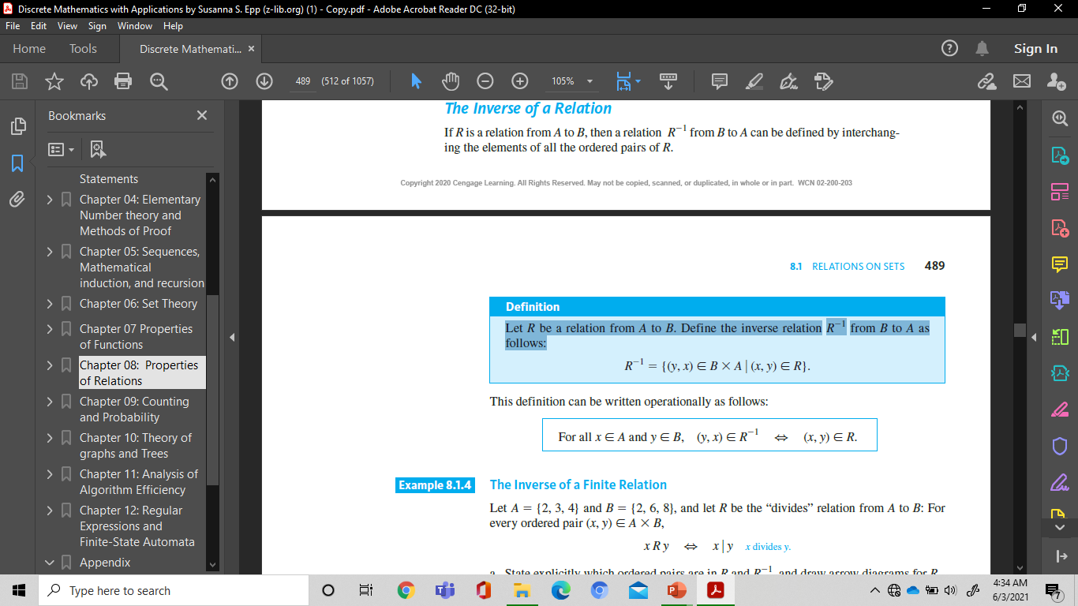
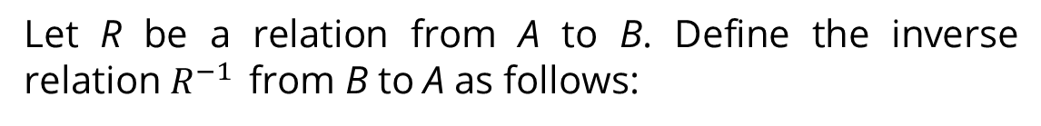
The Inverse of a Relation
Definition
Let R be a relation from A to B. Define the inverse relation $R^{−1 }$ from B to A as follows:
This definition can be written operationally as follows:
For all x$∈A and y∈B, \left(y,x\right)∈R^{−1 }⇔ (x,y)∈R$

Slide 10
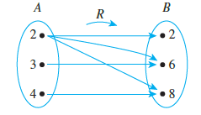
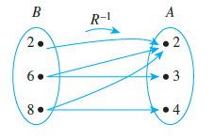
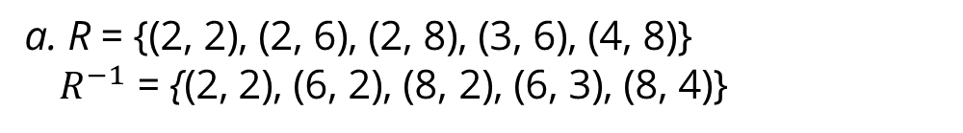
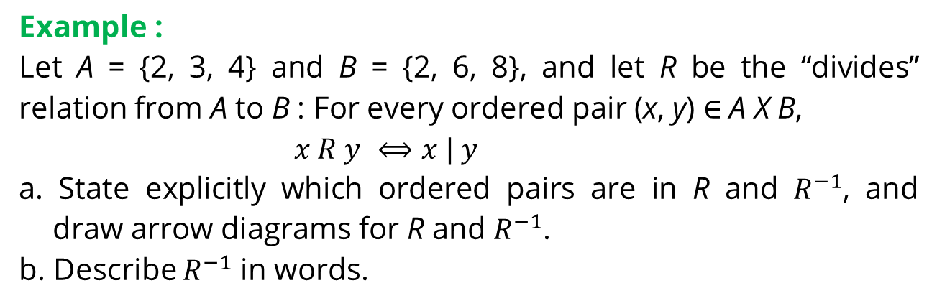
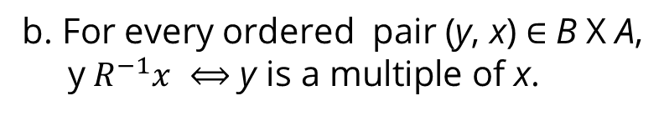
The Inverse of a Finite Relation
Example :
Let A = {2, 3, 4} and B = {2, 6, 8}, and let R be the “divides” relation from A to B : For every ordered pair (x, y) $∈$ A X B,
$x R y$ $⟺x | y$
a. State explicitly which ordered pairs are in R and $R^{−1}$, and draw arrow diagrams for R and $R^{−1}$.
b. Describe $R^{−1}$ in words.
Solution :
a. R = {(2, 2), (2, 6), (2, 8), (3, 6), (4, 8)}
${ R}^{−1}$ = {(2, 2), (6, 2), (8, 2), (6, 3), (8, 4)}
b. For every ordered pair (y, x) $∈$ B X A,
y${ R}^{−1}x$ $⟺\text{y} \text{is} \text{a} \text{multiple} \text{of} \text{x}\text{.}$

Slide 11
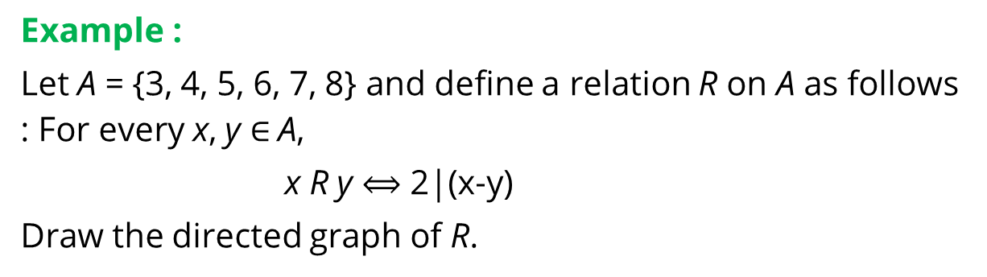

Directed Graph of a Relation
Definition
A relation on a set A is a relation from A to A.
For all points x and y in A, there is an arrow from
x to y $⟺$ x R y $⟺$ (x, y) $∈$ R.
Example :
Let A = {3, 4, 5, 6, 7, 8} and define a relation R on A as follows : For every x, y $∈$A,
x R y $⟺$ 2|(x-y)
Draw the directed graph of R.

Slide 12
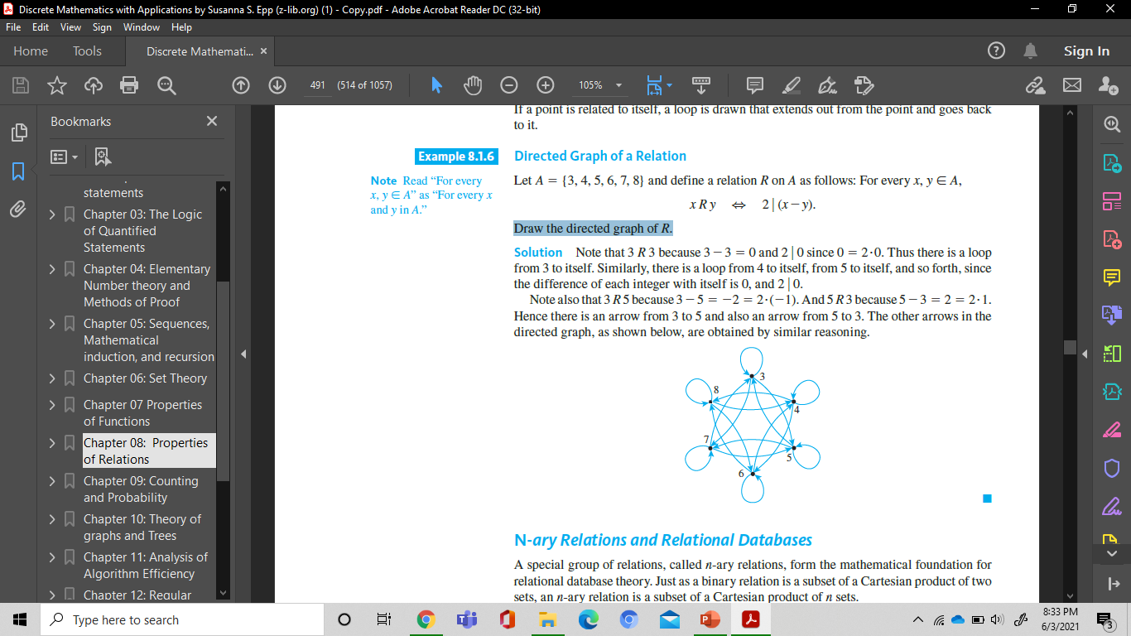
Directed Graph of a Relation
Solution:
3 R 3 because 3-3 =0
2|0 since 0 = 2.0.
Thus there is a loop from 3 to itself. Similarly, there is a loop from 4 to itself, from 5 to itself, and so forth, since the difference of each integer with itself is 0, and 2|0.
3R5 because 3-5 = -2 = -1.2
5R3 because 5-3 = 2= 2.1.
Hence there is an arrow from 3 to 5 and also an arrow from 5 to 3.

Slide 13
Reflexivity, Symmetry, And Transitivity
Mathematics is the tool specially suited for dealing with abstract concepts of any kind and there is no limit to its power in this field. —P. A. M. Dirac, 1902–1984

Slide 14
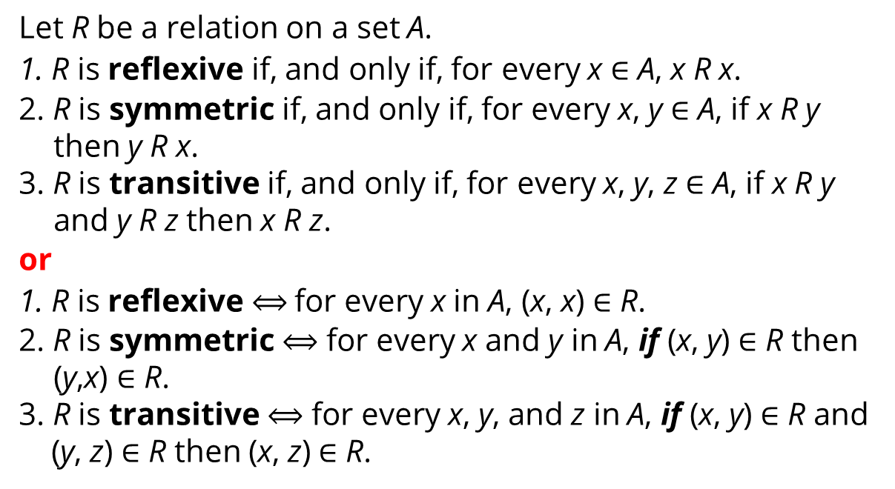
Properties of General
Relations
Definition
Let R be a relation on a set A.
1. R is reflexive if, and only if, for every x $∈$ A, x R x.
2. R is symmetric if, and only if, for every x, y $∈$ A, if x R y then y R x.
3. R is transitive if, and only if, for every x, y, z $∈$ A, if x R y and y R z then x R z.
or
1. R is reflexive $⟺$for every x in A, (x, x) $∈$ R.
2. R is symmetric $⟺$ for every x and y in A, if (x, y) $∈$ R then (y,x) $∈$ R.
3. R is transitive $⟺$ for every x, y, and z in A, if (x, y) $∈$ R and
(y, z) $∈$ R then (x, z) $∈$ R.

Slide 15
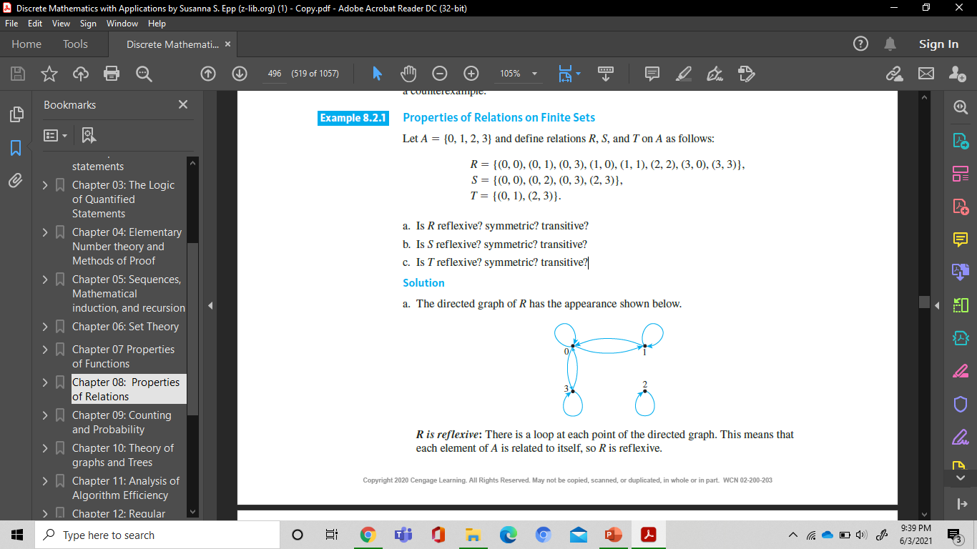
Properties of Relations on Finite Sets
Example :
Let A = {0, 1, 2, 3} and define relations R, S, and T on A as follows:
R = {(0, 0), (0, 1), (0, 3), (1, 0), (1, 1), (2, 2), (3, 0), (3, 3)},
S = {(0, 0), (0, 2), (0, 3), (2, 3)},
T = {(0, 1), (2, 3)}.
a. Is R reflexive? symmetric? transitive?
b. Is S reflexive? symmetric? transitive?
c. Is T reflexive? symmetric? transitive?
Solution (1) :
a. The directed graph of R :

Slide 16
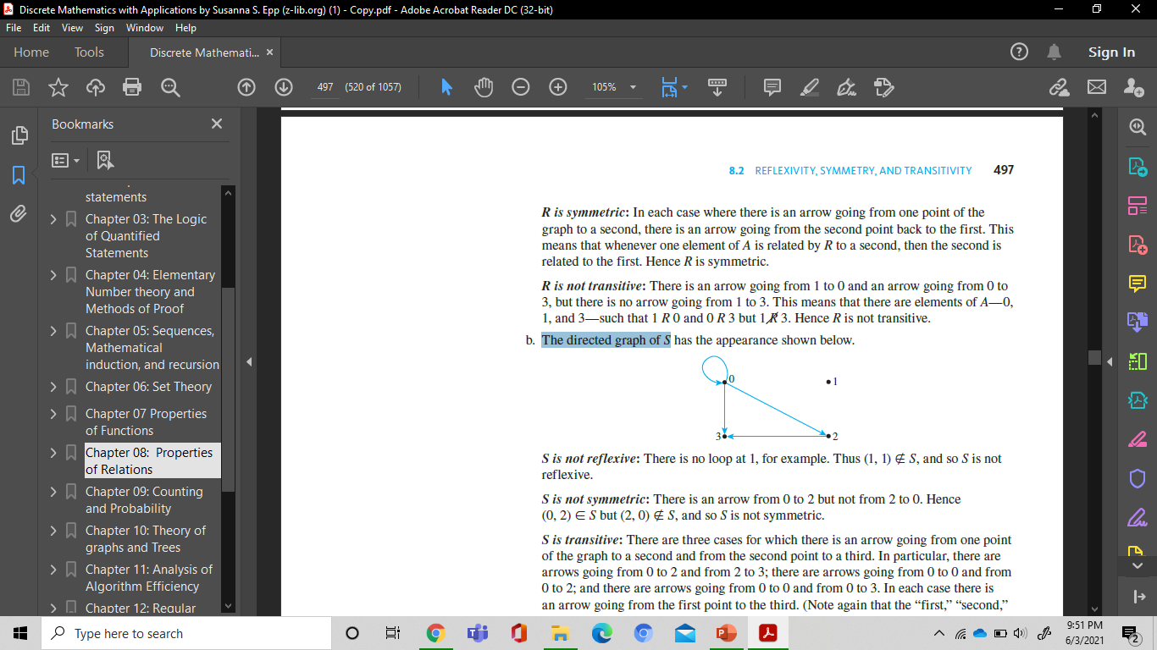
Properties of Relations on Finite Sets
Solution (2) :
a. R is reflexive: each element of A is related to itself, so R is reflexive.
R is symmetric: whenever one element of A is related by R to a second, then the second is related to the first. Hence R is symmetric.
R is not transitive: There is an arrow going from 1 to 0 and an arrow going from 0 to 3, but there is no arrow going from 1 to 3, such that 1 R 0 and 0 R 3 but 1 R 3. Hence R is not transitive.
b. The directed graph of S :

Slide 17
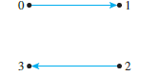
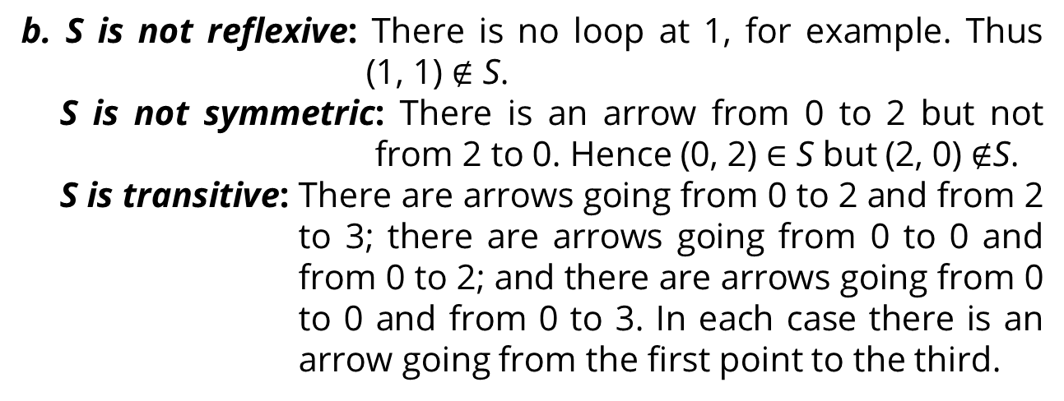
Properties of Relations on Finite Sets
Solution (3) :
b. S is not reflexive: There is no loop at 1, for example. Thus
(1, 1) $∉$ S.
S is not symmetric: There is an arrow from 0 to 2 but not from 2 to 0. Hence (0, 2) $∈$ S but (2, 0) $∉$S.
S is transitive: There are arrows going from 0 to 2 and from 2 to 3; there are arrows going from 0 to 0 and from 0 to 2; and there are arrows going from 0 to 0 and from 0 to 3. In each case there is an arrow going from the first point to the third.
c. The directed graph of T

Slide 18
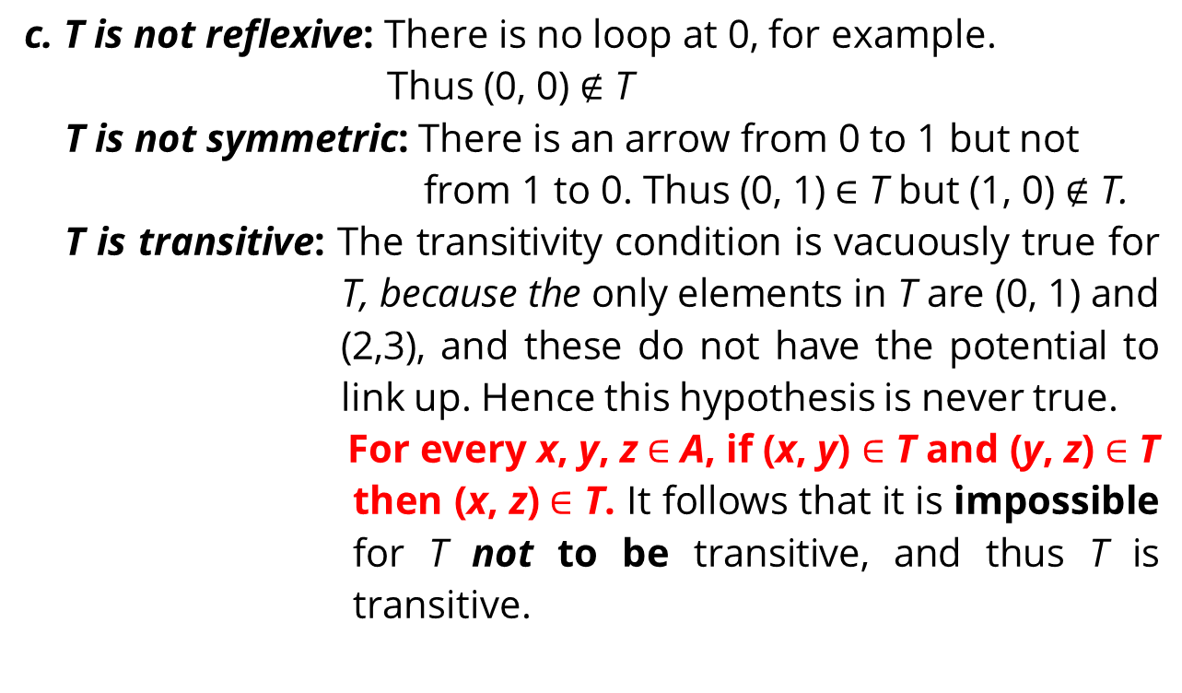
Properties of Relations on Finite Sets
Solution (4) :
c. T is not reflexive: There is no loop at 0, for example.
Thus (0, 0) $∉$ T
T is not symmetric: There is an arrow from 0 to 1 but not from 1 to 0. Thus (0, 1) $∈$ T but (1, 0) $∉$ T.
T is transitive: The transitivity condition is vacuously true for T, because the only elements in T are (0, 1) and (2,3), and these do not have the potential to link up. Hence this hypothesis is never true.
For every x, y, z $∈$ A, if (x, y) $∈$ T and (y, z) $∈$ T then (x, z) $∈$ T. It follows that it is impossible for T not to be transitive, and thus T is transitive.

Slide 19
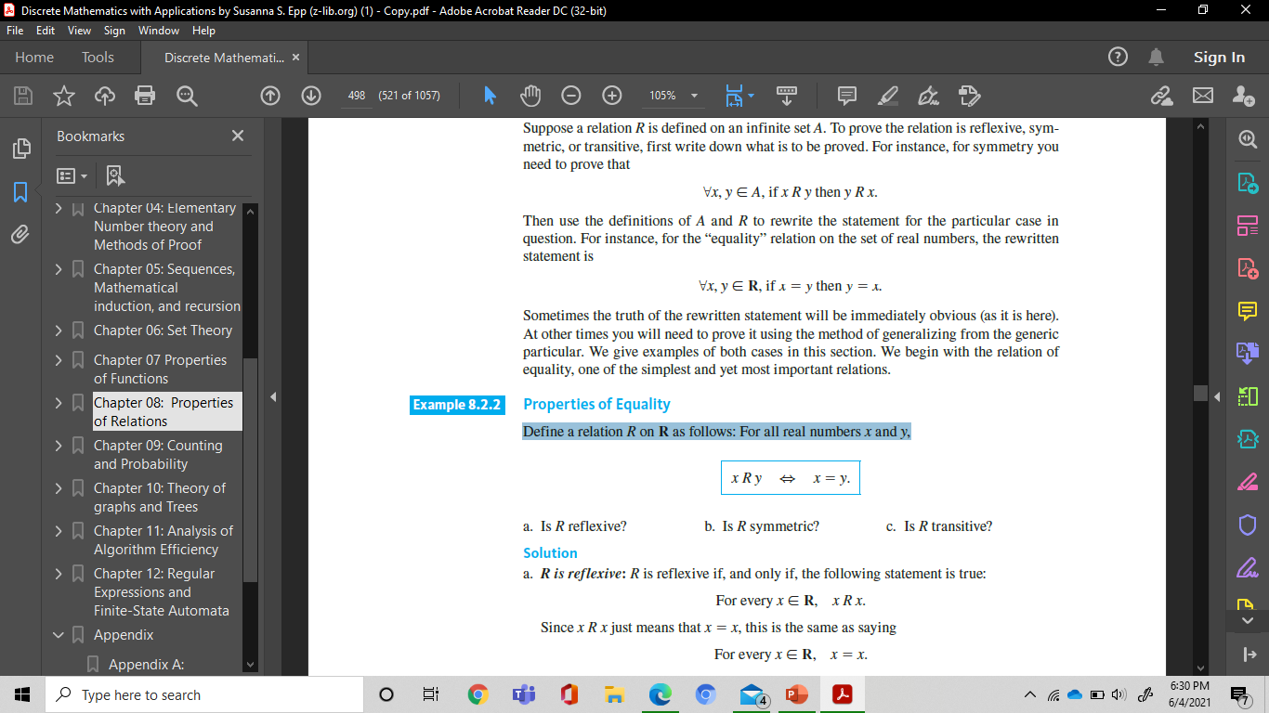
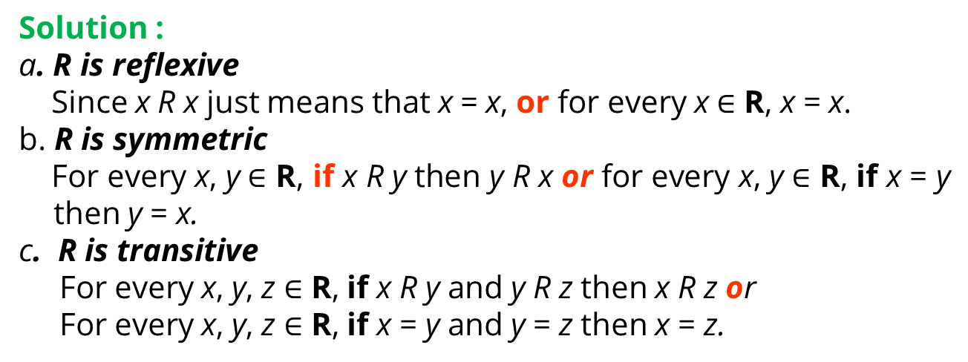
Properties of equality
Example :
Define a relation R on R as follows: For all real numbers x and y,
a. Is R reflexive? b. Is R symmetric? c. Is R transitive?
Solution :
a. R is reflexive
Since x R x just means that x = x, or for every x $∈$ R, x = x.
b. R is symmetric
For every x, y $∈$ R, if x R y then y R x or for every x, y $∈$ R, if x = y then y = x.
c. R is transitive
For every x, y, z $∈$ R, if x R y and y R z then x R z or
For every x, y, z $∈$ R, if x = y and y = z then x = z.

Slide 20

Properties of “Less Than” (1)
Example :
Define a relation R on R (the set of all real numbers) as follows: For all x, y ∈ R,
Is R reflexive?
Is R symmetric?
Is R transitive?

Slide 21
Properties of “Less Than” (2)
Solution :
a. R is not reflexive
By definition of R, this means that ∀x ∈ R, x < x. But this is false: ∃x ∈ R such that x ≮ x. As a counterexample, let x = 0 and note that 0 ≮ 0.
b. R is not symmetric
By definition of R, this means that ∀x, y ∈ R, if x < y then y < x. But this is false: ∃x, y ∈ R such that x < y and y ≮ x. As a counterexample, let x = 0 and y = 1 and note that 0 < 1 but 1 ≮ 0.
c. R is transitive:
By definition of R, this means that for all x, y, z ∈ R, if x < y and y < z, then x < z. This statement is true by the transitive law of order for real numbers.

Slide 22
Equivalence Relation

Slide 23
Definition of an Equivalence
Relation
Definition
Let A be a set and R a binary relation on A. R is an equivalence relation if, and only if, R is reflexive, symmetric, and transitive
Example:
Let X be the set of all nonempty subsets of {1, 2, 3}. Then
X = {{1}, {2}, {3}, {1, 2}, {1, 3}, {2, 3}, {1, 2, 3}}
Define a relation R on X as follows: For all A and B in X,
A R B ⇔ the least element of A equals the least element of B.
Prove that R is an equivalence relation on X.

Slide 24
an equivalence relation on a set of subsets
Solution :
R is reflexive:
Suppose A is a nonempty subset of {1, 2, 3}.
It is true to say that the least element of A equals the least element of A. Thus, by definition of R, A R A.
R is symmetric:
Suppose A and B are nonempty subsets of {1, 2, 3} and A R B.
Since A R B, the least element of A equals the least element of B. But this implies that the least element of B equals the least element of A, and so, by definition of R, B R A.

Slide 25
an equivalence relation on a set of subsets
R is transitive:
Suppose A, B, and C are nonempty subsets of {1, 2, 3}, A R B, and B R C.
Since A R B, the least element of A equals the least element of B and since B R C, the least element of B equals the least element of C. Thus the least element of A equals the least element of C, and so, by definition of R, A R C.

Slide 26
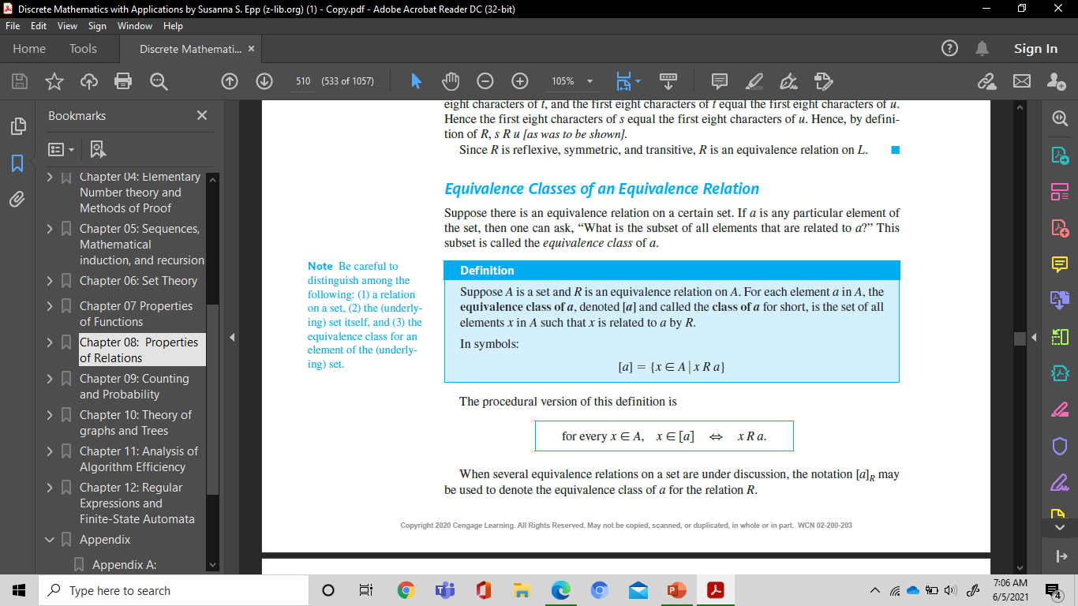

Equivalence Classes of an
Equivalence Relation
Definition
Suppose A is a set and R is an equivalence relation on A. For each element a in A, the equivalence class of a, denoted [a] and called the class of a for short, is the set of all elements x in A such that x is related to a by R.
In symbols:
or

Slide 27
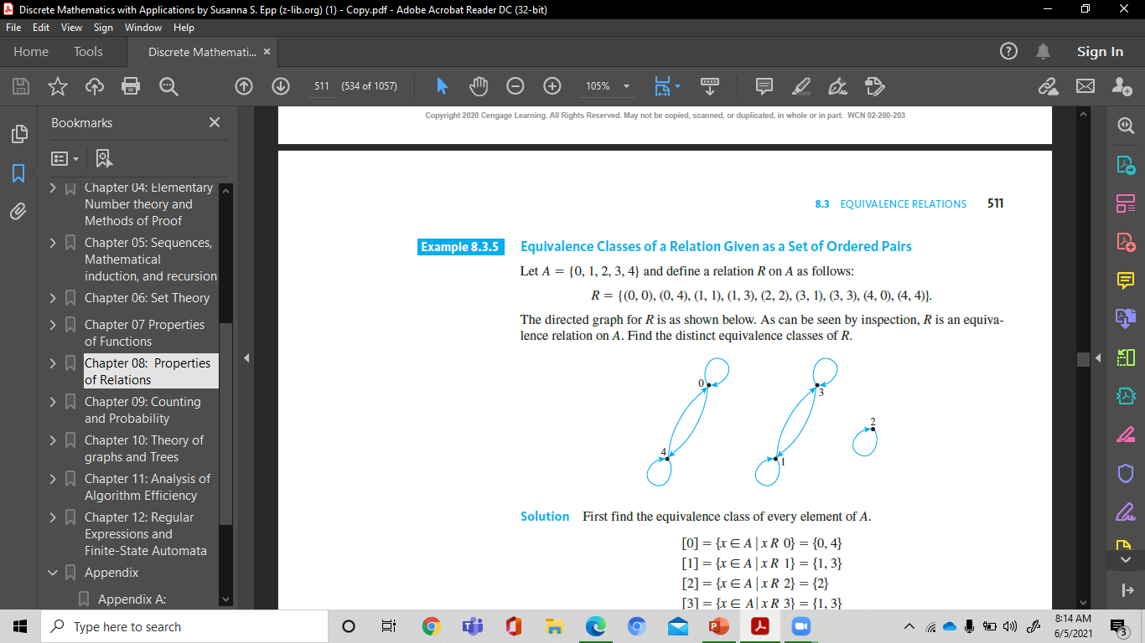
Equivalence Classes of a relation Given as a set of ordered Pairs
Example :
Let A 5 {0, 1, 2, 3, 4} and define a relation R on A as follows:
R = {(0, 0), (0, 4), (1, 1), (1, 3), (2, 2), (3, 1), (3, 3), (4, 0), (4, 4)}.
The directed graph for R is as shown below. As can be seen by inspection, R is an equivalence relation on A. Find the distinct equivalence classes of R.

Slide 28
Equivalence Classes of a relation Given as a set of ordered Pairs
Solution :
First find the equivalence class of every element of A.
[0] = {x ∈ A| x R 0} = {0, 4}
[1] = {x ∈ A| x R 1} = {1, 3}
[2] = {x ∈ A| x R 2} = {2}
[3] = {x ∈ A| x R 3} = {1, 3}
[4] = {x ∈ A| x R 4} = {0, 4}
Note that [0] = [4] and [1] = [3].
Thus the distinct equivalence classes of the relation are
{0, 4}, {1, 3}, and {2}.

Slide 29
Partial Order Relations
There Is No Branch Of Mathematics, However Abstract, Which May Not Some Day Be Applied To Phenomena Of The Real World. —Nicolai Ivanovitch Lobachevsky, 1792–1856

Slide 30
Antisymmetry
Definition
Let R be a relation on a set A. R is antisymmetric if, and only if, for every a and b in A, if a R b and b R a then a = b.
Example : Antisymmetry of Finite Relations
Let R1 and R2 be the relations on {0, 1, 2} defined as follows: Draw the directed graphs for R1 and R2 and indicate which relations are antisymmetric.
R1 = {(0, 2), (1, 2), (2, 0)}
R2 = {(0, 0), (0, 1), (0, 2), (1, 1), (1, 2)}

Slide 31
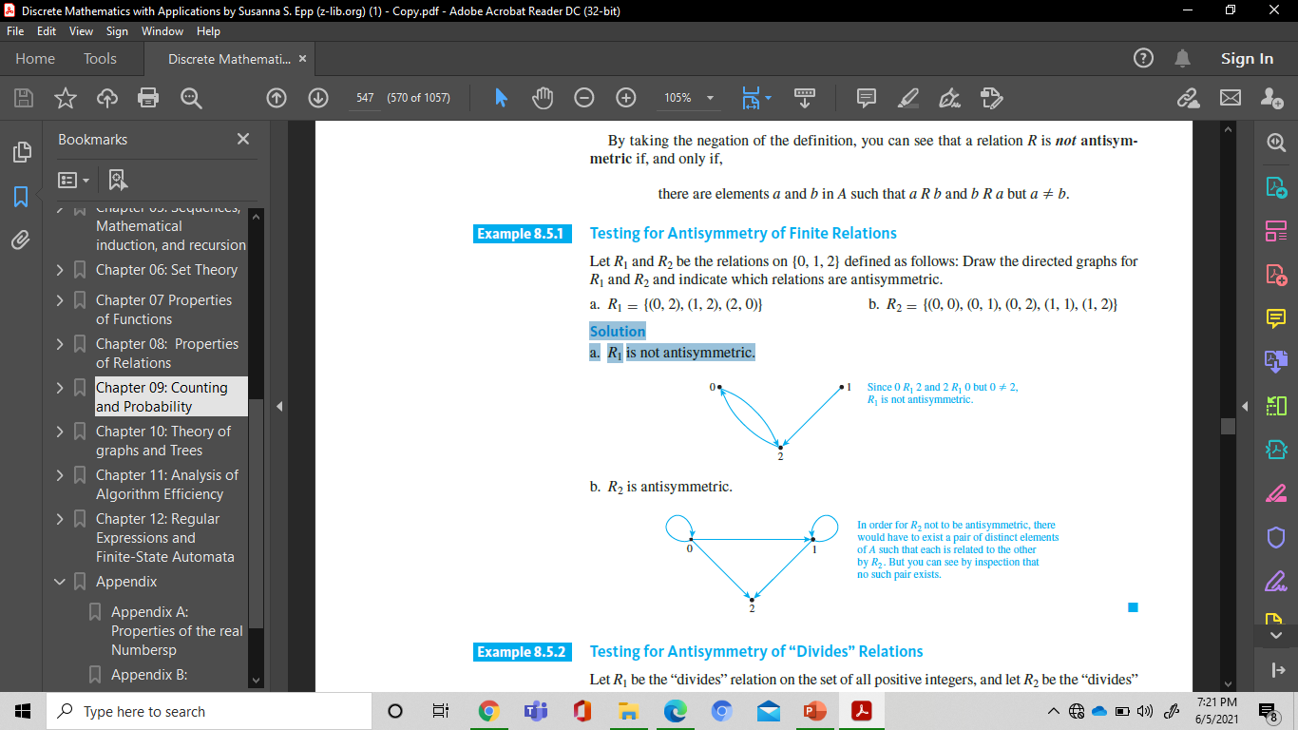
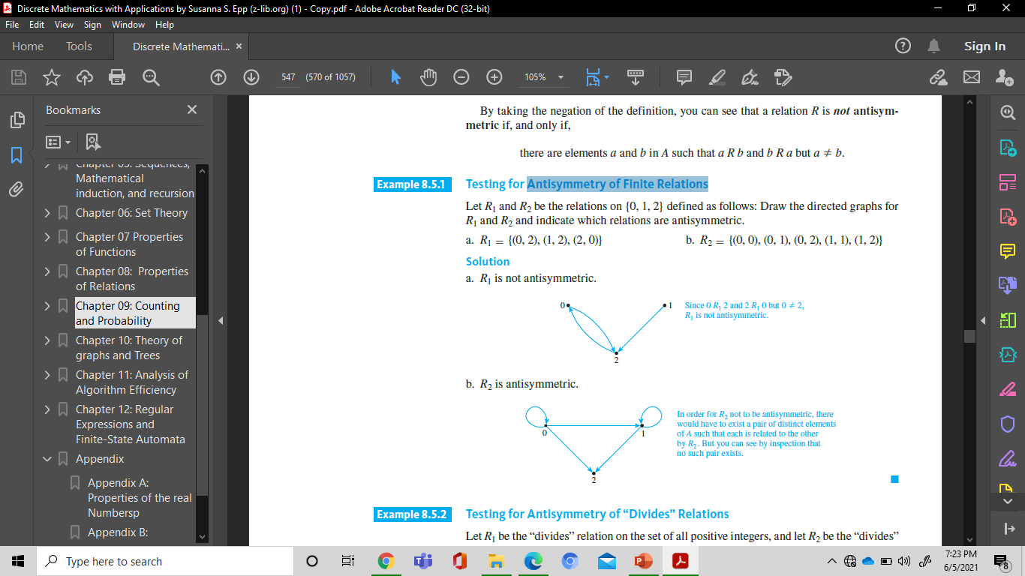
Antisymmetry
Solution :
a. R1 is not antisymmetric.
b. R2 is antisymmetric.

Slide 32
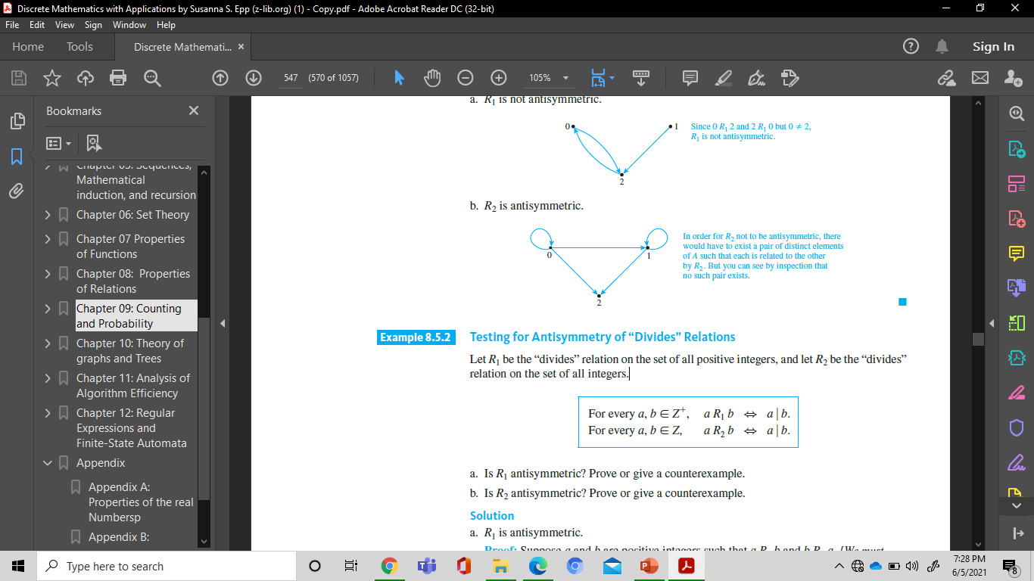
Antisymmetry of “Divides” Relations
Example :
Let R1 be the “divides” relation on the set of all positive integers, and let R2 be the “divides” relation on the set of all integers.
a. Is R1 antisymmetric? Prove or give a counterexample.
b. Is R2 antisymmetric? Prove or give a counterexample.

Slide 33
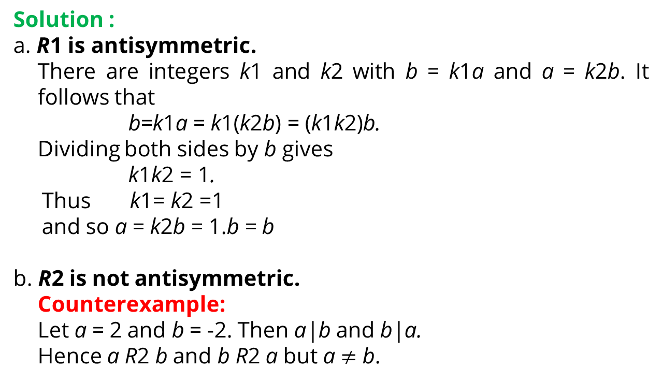
Antisymmetry of “Divides” Relations
Solution :
a. R1 is antisymmetric.
There are integers k1 and k2 with b = k1a and a = k2b. It follows that
b=k1a = k1(k2b) = (k1k2)b.
Dividing both sides by b gives
k1k2 = 1.
Thus k1= k2 =1
and so a = k2b = 1.b = b
b. R2 is not antisymmetric.
Counterexample:
Let a = 2 and b = -2. Then a|b and b|a.
Hence a R2 b and b R2 a but a $≠$ b.

Slide 34
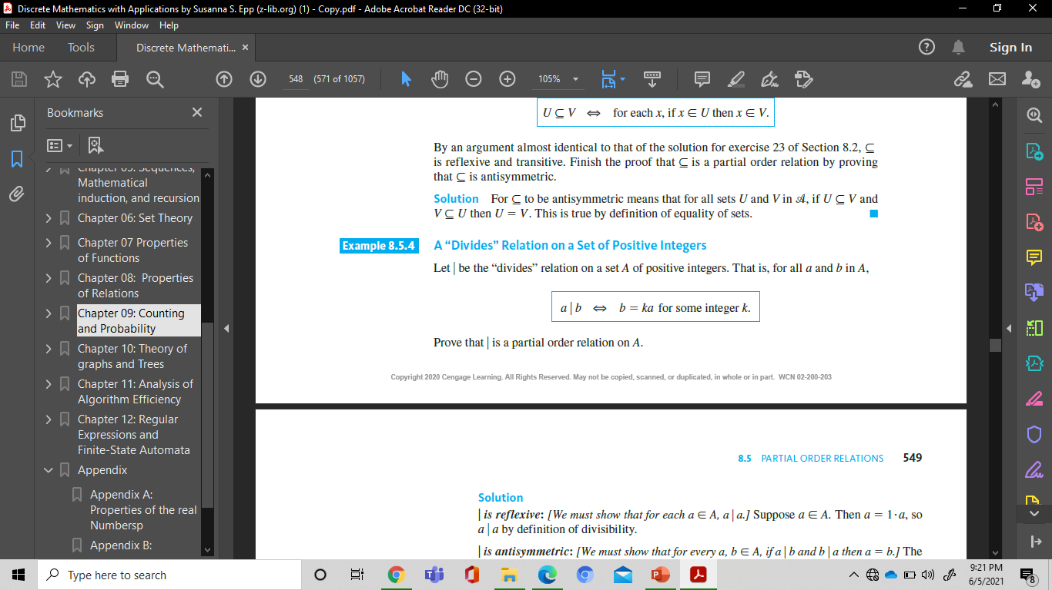
Partial Order Relations
Definition
Let R be a relation defined on a set A. R is a partial order relation if, and only if, R is reflexive, antisymmetric, and transitive.
Example : a “Divides” relation on a set of Positive integers
Let u be the “divides” relation on a set A of positive integers. That is, for all a and b in A,
Prove that | is a partial order relation on A.

Slide 35
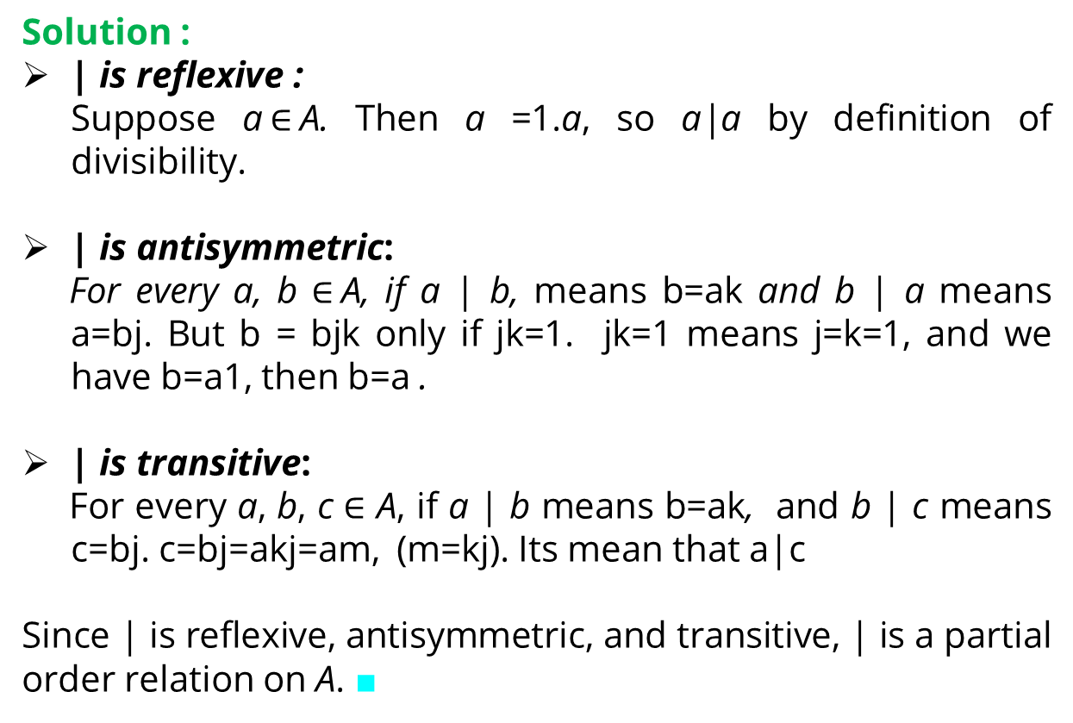
Partial Order Relations
Solution :
| is reflexive :
Suppose a$∈$A. Then a =1.a, so a|a by definition of divisibility.
| is antisymmetric:
For every a, b $∈$A, if a | b, means b=ak and b | a means a=bj. But b = bjk only if jk=1. jk=1 means j=k=1, and we have b=a1, then b=a .
| is transitive:
For every a, b, c $∈$ A, if a | b means b=ak, and b | c means c=bj. c=bj=akj=am, (m=kj). Its mean that a|c
Since | is reflexive, antisymmetric, and transitive, | is a partial order relation on A. ■

Slide 36
Hasse Diagrams
Hasse Diagram : a somewhat simpler graph, with a partial order relation defined on a finite set.
The procees to obtain a Hasse diagram :
Start with a directed graph of the relation, placing vertices on the page so that all arrows point upward.
Then eliminate :
1. the loops at all the vertices,
2. all arrows whose existence is implied by the transitive property
3. the direction indicators on the arrows.

Slide 37
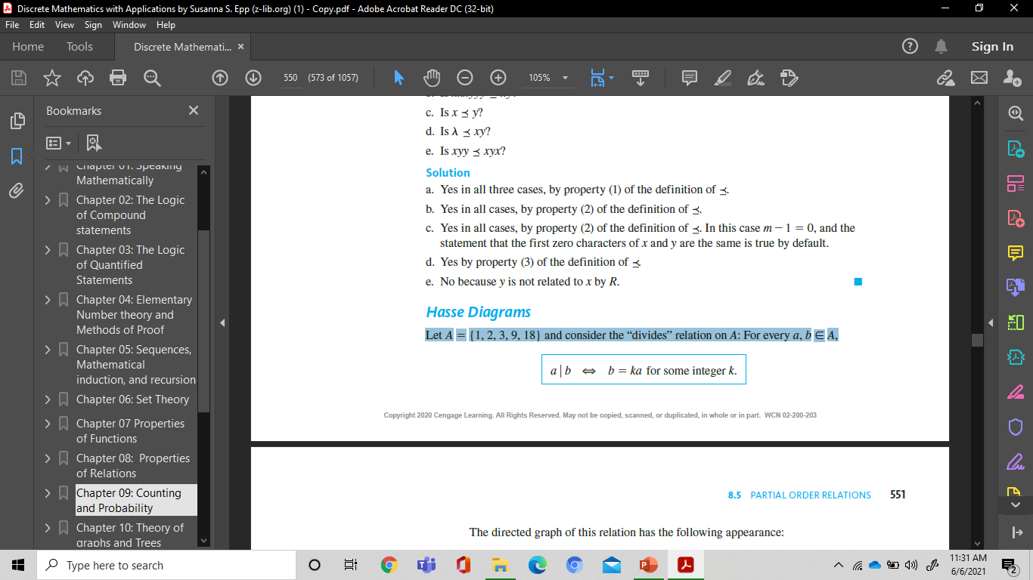
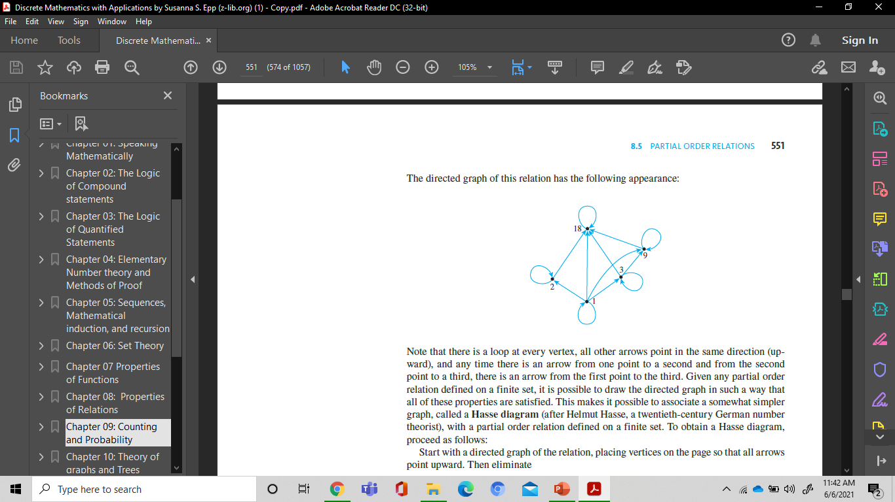
Hasse Diagrams
Example 1 :
Let A 5 {1, 2, 3, 9, 18} and consider the “divides” relation on A: For every a, b ∈ A,
The directed graph of this relation has the following appearance:

Slide 38
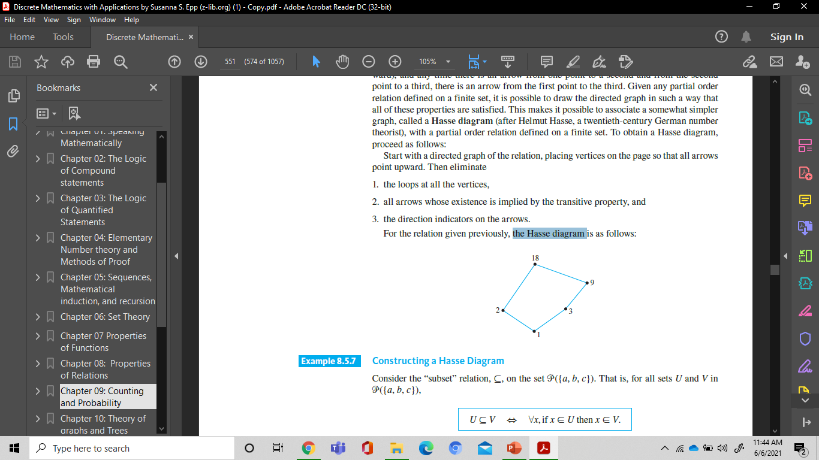
Hasse Diagrams
The Hasse diagram :

Slide 39
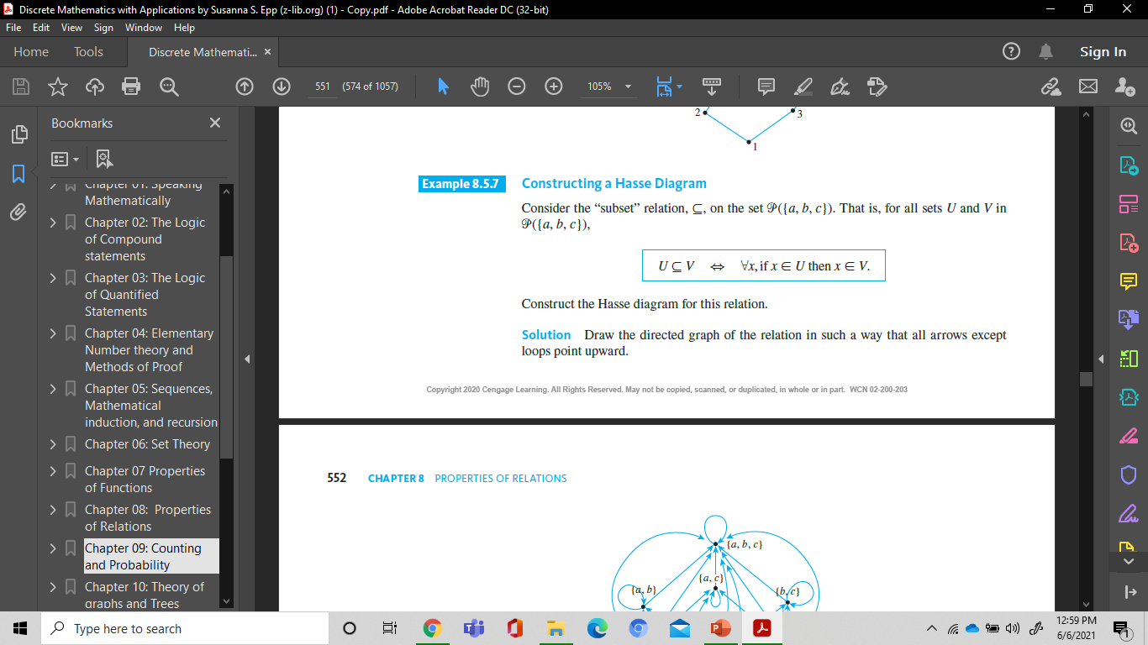
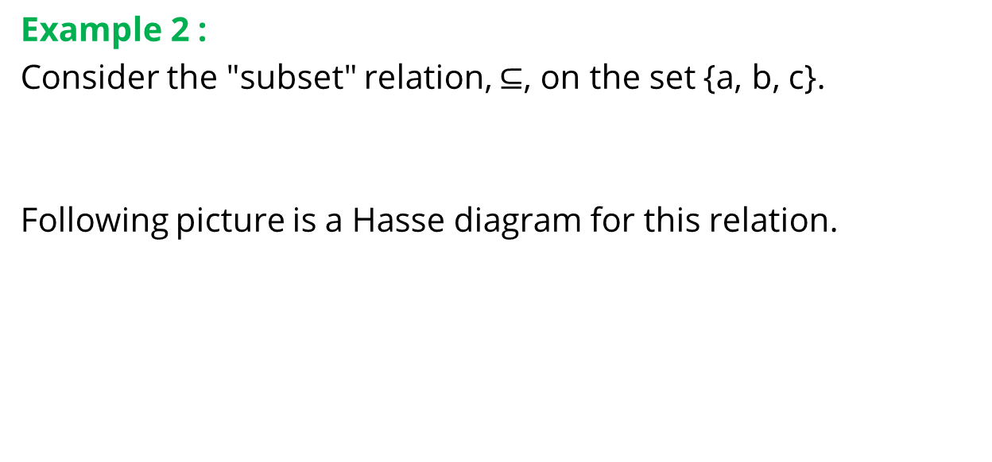
Example: Hasse Diagrams
Example 2 :
Consider the "subset" relation, $⊆$, on the set {a, b, c}.
Following picture is a Hasse diagram for this relation.
{a,b,c}
{a,c}
{a,b}
{b,c}
{b}
{a}
{c}
{}

Slide 40
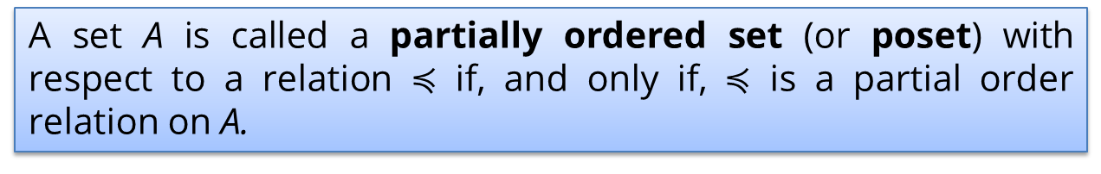
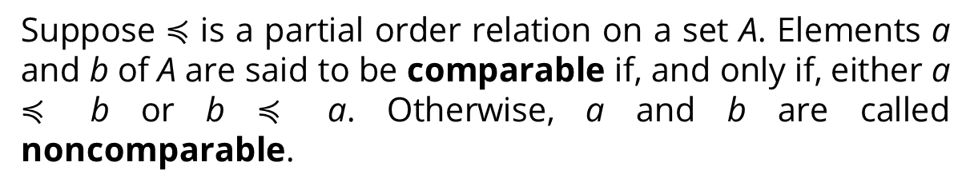
Partially and Totally Ordered Sets
Definition
Suppose $≼$ is a partial order relation on a set A. Elements a and b of A are said to be comparable if, and only if, either a $≼$ b or b $≼$ a. Otherwise, a and b are called noncomparable.
Example :
In poset (Z⁺, |) :
3 and 6, 6 and 3 are comparable,
3 and 5 , 8 and 12 are noncomparable.
A set A is called a partially ordered set (or poset) with respect to a relation $≼$ if, and only if, $≼$ is a partial order relation on A.

Slide 41
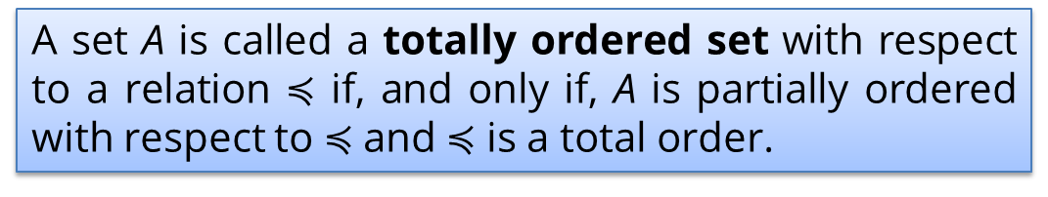
Partially and Totally Ordered Sets
Definition
If R is a partial order relation on a set A, and for any two elements a and b in A either a R b or b R a, then R is a total order relation on A.
Example :
(Z⁺, ≤), is a total order, because for every pair (a,b) in ZxZ, either a ≤ b, or b ≤ a.
4
3
A set A is called a totally ordered set with respect to a relation $≼$ if, and only if, A is partially ordered with respect to $≼$and $≼$ is a total order.
2
1

Slide 42
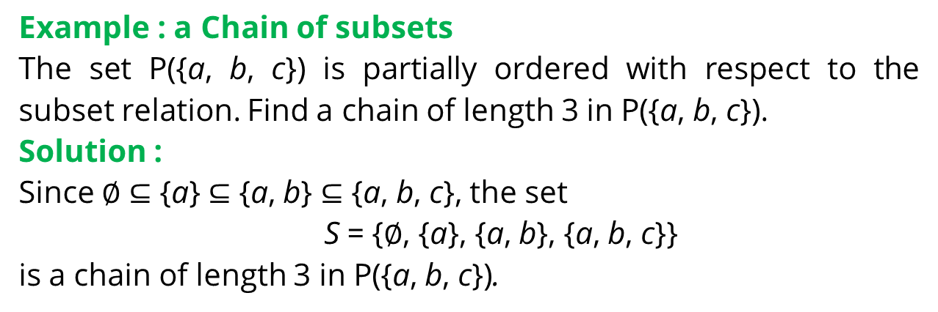
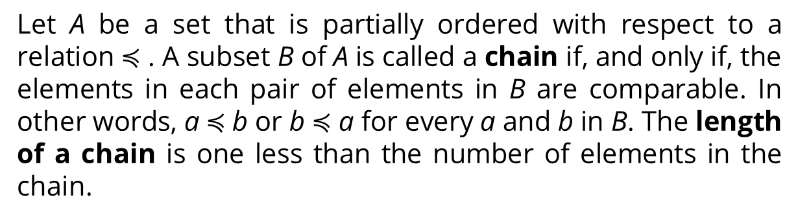
Partially and Totally Ordered Sets
Definition
Let A be a set that is partially ordered with respect to a relation $≼$ . A subset B of A is called a chain if, and only if, the elements in each pair of elements in B are comparable. In other words, a $≼$b or b $≼$ a for every a and b in B. The length of a chain is one less than the number of elements in the chain.
Example : a Chain of subsets
The set P({a, b, c}) is partially ordered with respect to the subset relation. Find a chain of length 3 in P({a, b, c}).
Solution :
Since $∅$ $⊆$ {a} $⊆$ {a, b} $⊆$ {a, b, c}, the set
S = {$∅$, {a}, {a, b}, {a, b, c}}
is a chain of length 3 in P({a, b, c}).

Slide 43
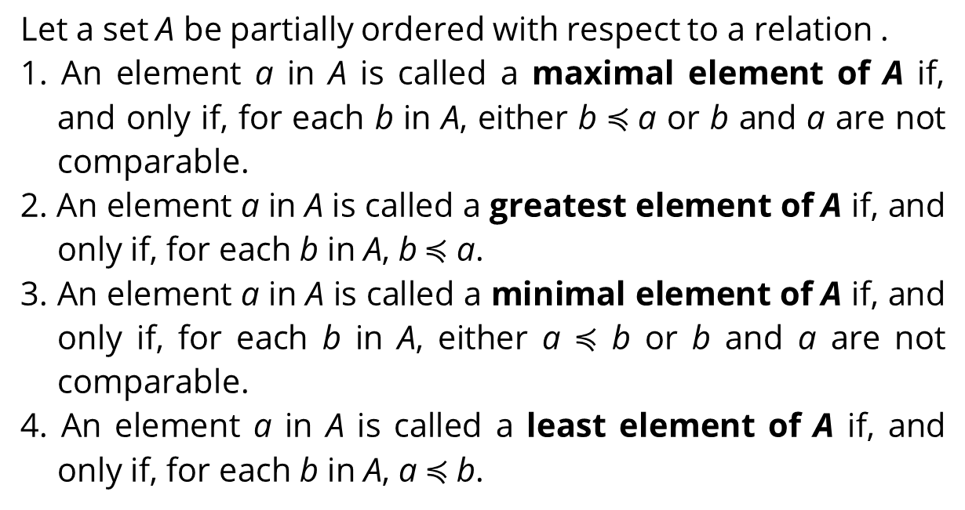
Element of Hasse Diagram
Definition
Let a set A be partially ordered with respect to a relation .
1. An element a in A is called a maximal element of A if, and only if, for each b in A, either b $≼$a or b and a are not comparable.
2. An element a in A is called a greatest element of A if, and only if, for each b in A, b $≼$ a.
3. An element a in A is called a minimal element of A if, and only if, for each b in A, either a $≼$ b or b and a are not comparable.
4. An element a in A is called a least element of A if, and only if, for each b in A, a $≼$b.

Slide 44
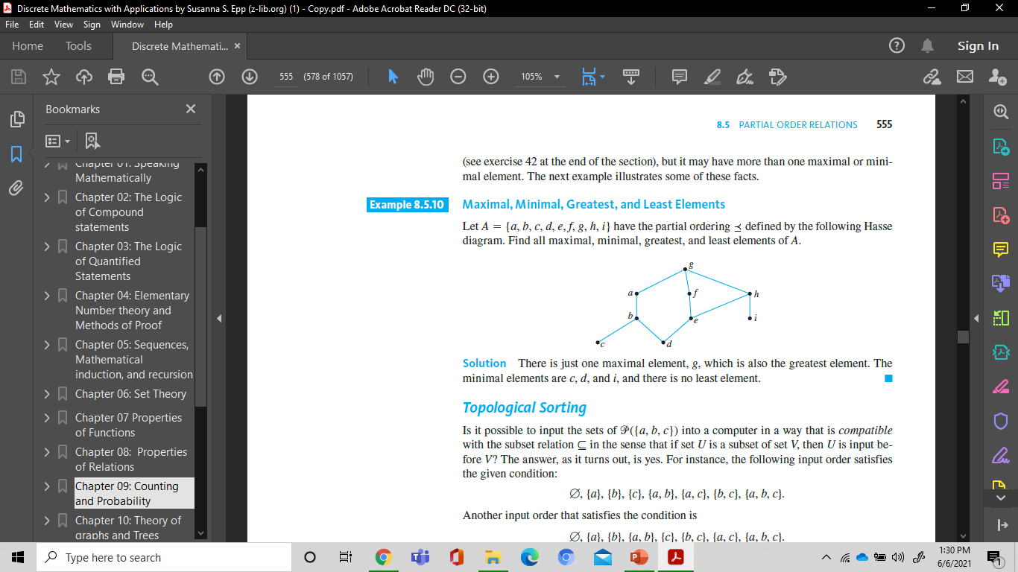
Maximal, Minimal, Greatest, and least elements
Example :
Let A = {a, b, c, d, e, f, g, h, i} have the partial ordering defined by the following Hasse diagram. Find all maximal, minimal, greatest, and least elements of A.
Solution:
Maximal element : g
The greatest element : g
The minimal elements : c, d, and i, and
There is no least element.

Slide 45
UB, LB, LUB, and GLB
Let (S, ≤) be a partial order. If A ⊆ S, then
An upper bound (UB) for A is any element x ∈ S (perhaps in A also) such that ∀ a ∈ A, a ≤ x.
A lower bound (LB) for A is any element x ∈ S such that ∀ a ∈ A, a ≥ x.
x ∈ S is a least upper bound (LUB) for A if x is an upper bound and for upper bound y of A, y ≥ x.
x is a greatest lower bound (GLB) for A if x is a lower bound and if x ≤ y for every UB y of A.

Slide 46
Example: UB and LB
The upper bound of {g,j} is a. Why not b?
The lower bounds of {a,b} are d, f, i, and j.
(1) (2)
a
b
a
b
c
d
c
d
e
e
f
f
j
j
g
h
i
g
h
i

Slide 47
Example: LUB and GLB
In picture 1, c and d are lower bounds for {a,b}, but there is no GLB. This is because c and d are incomparable.
Similarly, a and b are upper bounds
for {c,d}, but there is no LUB
From picture 2, LUB of {i,j} = d
From picture 2, GLB of {g,j} is…
(1) (2)
a
b
c
d
a
b
e
f
j
c
d
g
h
i

Slide 48
References
Susanna S.Epp, “ Discrete Mathematics with Applications”, 5th edition,2020, Cengage, Boston, USA, ISBN 9781337694193
Kenneth H. Rosen, “ Discrete Mathematics and its Applications”, 8th edition,2019, McGraw-Hill Education, New York, ISBN 978-1-259-67651-2

Slide 49
THANK YOU

